Slide 1

Battle of Neighborhoods A new restaurant in Los Angeles, CA by Yogendra Parth Sarthy(April 2020)

Slide 2
The project (Jupyter Notebook)
You can find the Jupyter Notebook that I used to ellaborate the data and reach the final conclussions here:
Los Angeles New restaurant Project
and also you may find interesting the Notebook I programmed to specifically extract Los Angeles data from the Wikipedia:
Los Angeles Wikipedia Extractor

Slide 3
1.- Introduction (Business requirements)
As we discussed in the orevious week project, the main goal of this project is to find a good opportunity in Los Angeles, CA for opening a new restaurant.
We need to take into account that Los Angeles is multi-cultural city (probably one of the most diverse in the world) and opening a new restaurant may be a financial risk if you don't measure all the different variables.
Our financial partners don't need to start a restaurant for an specific food type. They have the money to start a new business and they think a restaurant in LA, where they have their headquarters, could be a good choice.
Based on that, we need to accomplish two requirements and use available free internet data:
Select the food type for our restaurant
Choose the neighborhood where we will place our restaurant

Slide 4
2.- Data Requirements
We will retrieve our data from two different sources:
Wikipedia: list of Los Angeles neighborhoods & districts
Foursquare: list of restaurants for each of the neighborhoods
We will also use Nominatim API to get geographic coordinates for each place

Slide 5
3.- Data understanding
List of neighborhoods:
We need to clean or remove those districts that seem to have incorrect information in Wikipedia. After analyzing each of them, it is not relevant to remove part of them as they are only small zones. Note that even we remove a small district, their restaurants will be in the venues list because they are enough close to another main district or neighborhood.
List of venues (restaurants):
Though we specified Restaurant as the query for Foursquare API it returns some venues that are not really restaurants. We have to detect these cases and axclude them from the final list.
Coordinates (GEO):
Some of the places are not geolocated. As we did with incorrect neighborhoods, we remove these places.

Slide 6
4.- Data preparation
Nominatin API problems
As we mentioned above, we are using Nominating to get the GEO coords for all the places we will analyze. When we iterate the list of places and invoke Nominnating API, we get a Service unavailable error.
We dealt with this problem in the next way:
Set a delay of 1 second between each invocation
Save the results we get (for every coordinates we get) so that we don't need to repeat the process for the same items
Data filtering and transformation will be done always on the origina data, and not on data previously transformed or manipulated. This will allow us to perform as many tests as we need without the need of retrieving the original data again.
The original data is contained in two different csv files:
Neighborhoods .csv file
Venues .csv file

Slide 7
5.- Methodology I
o better understand the field and the problem we have to solve, we need to use visual tools that help us to make decisions.
First we will classify the data we have to understand which are the LA people preferences. For instance, probably we will not find any Scottish restaurant (or very few) but a bunch of Mexican or Latin restaurants.
Once we know the preferences we will choose a restaurant of this type based on these:
If we choose a type of food that LA people doesn't like now, we will have no competitors, but also we will have no customers
If we choose a type of food that LA people like now but we place it where there are a lot of competitors with the same food type, we will not have a lot of customers
We need to place a restaurant specialized in a food type that LA people likes in a neighborhood with few competitors. Does this exist?

Slide 8
5.- Methodology II
We need two tools for our purpose:
Ranking tools: Python Pandas and Numpy will be enough
Clustering tools: As we are clustering based on geographic coordinates it is recommendable to use DBSCAN algorithm
So, the steps to reach our conclusions will be:
Rank all the food types in LA to know what customers like
Select our top n food types to make the clustering analysis with
Select all the existing restaurant for the selected categories and place it in the map
Use clustering tools to divide the map into different numbered clusters
Classify food types / clusters using a weighted matrix
Analyze with maps and the matrix which are our options
Make a decision/recommendation

Slide 9
6.- Modeling
Important: Take into account that the details of the data modeling/analysis are contained in the Notebook. Here I will only place the images to easily explain the process

Slide 10
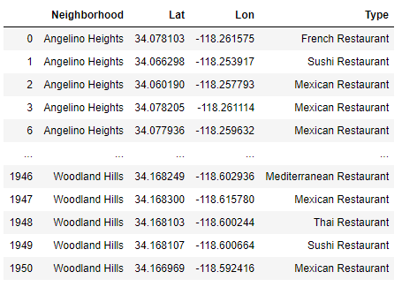
6.1 The restaurants dataframe

Slide 11
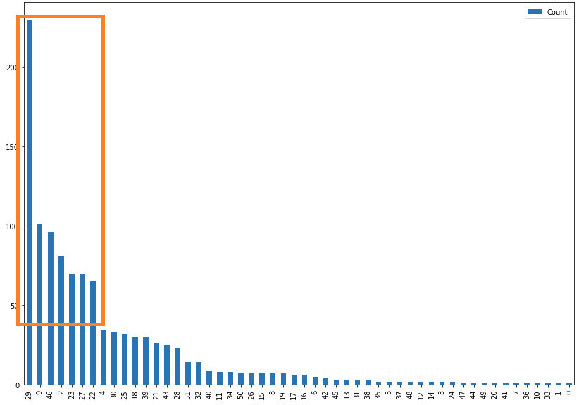
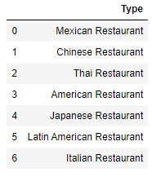
6.2 Choosing the top n food types

Slide 12
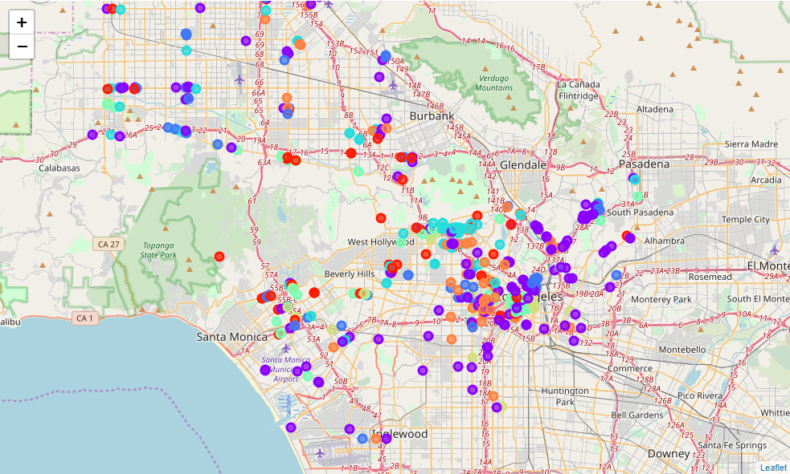
6.3 Map distribution of top 7 food types restaurants

Slide 13
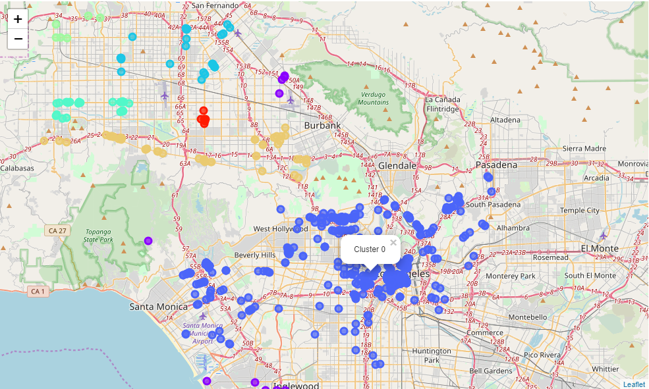
6.4 Clustering places with DBSCAN

Slide 14
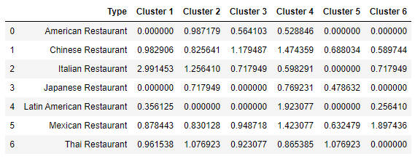
7 Type of Food x Cluster Matrix

Slide 15
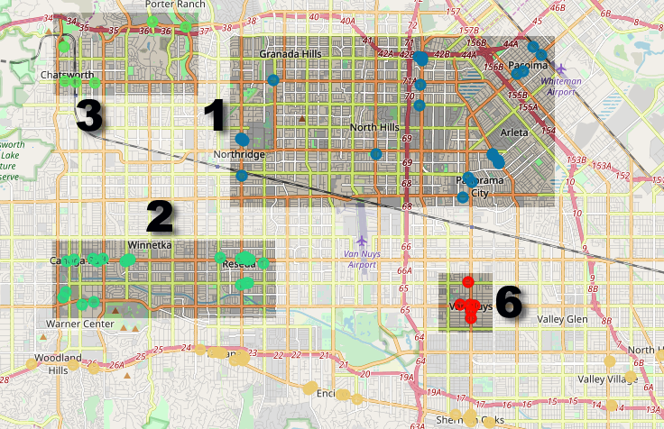
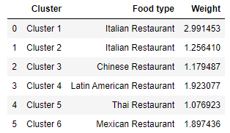
8 Final Analysis

Slide 16
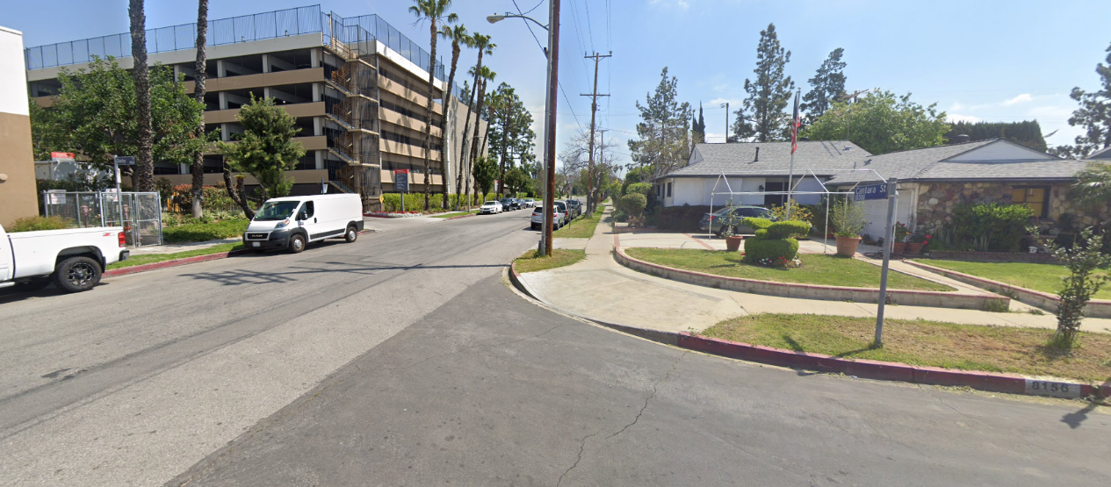
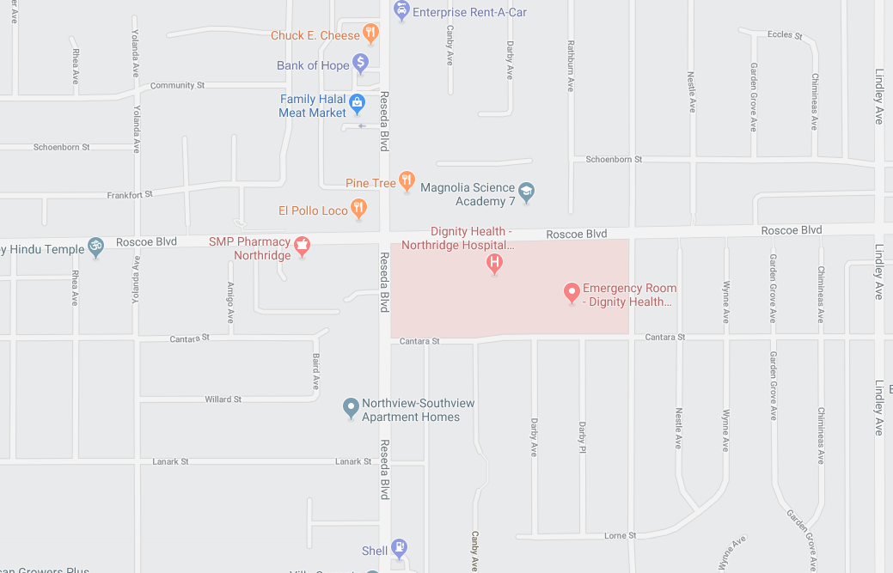
Conclusion
The weighted matrix shows that Cluster 1 and Cluster 2 are very good places to set an Italian Restaurant
Restaurant
“Regression to Pasta”

